Slide 1
University of North Texas
ADTA 5560: Recurrent Neural Networks for Sequence Data
Final Project Presentation
By: Biniam Abebe
Notes:
"Good [morning/afternoon], everyone. My name is Biniam Abebe, and today I’ll present the final project for ADTA 5560: Recurrent Neural Networks for Sequence Data. This project explores the implementation and analysis of RNN architectures, focusing on time-series data, simple RNNs, LSTMs, and performance optimization."

Slide 2
Table of Contents
Introduction
Time-series Dataset Selection
Simple RNN Implementation
LSTM Core Concepts
LSTM Implementation
Network Redesign
Performance Comparison
Conclusions

Slide 3
1. Introduction
Project Scope: Implementation and analysis of RNN architectures
Key Components:
Time series data analysis
Simple RNN implementation
LSTM network development
Performance optimization
Tools Used: TensorFlow, Python, Keras
Notes:
Speaker: "The scope of this project is to implement and analyze different RNN architectures for time-series data prediction. Specifically, we worked with a time-series dataset, explored Simple RNN and LSTM models, and redesigned neural networks to optimize performance. Tools used include TensorFlow, Keras, and Python."

Slide 4
2. Time-series Dataset Selection
Global Land-Ocean Temperature Index Data
Source: NASA's Goddard Institute for Space Studies (GISS)
Characteristics:
Monthly temperature measurements
144+ years of data (1880-present)
~1,700 data points
Format: CSV with temperature anomalies
Notes:
Speaker: "The dataset used is the Global Land-Ocean Temperature Index from NASA’s GISS. It provides over 144 years of monthly temperature anomalies, totaling around 1,700 observations. This dataset is ideal for time-series analysis because it offers consistent, high-quality measurements with real-world relevance for climate modeling."

Slide 5
3. Simple RNN Implementation
Sine Wave Prediction
Architecture:
Input Layer: 60 timesteps × 1 feature
SimpleRNN Layer 1: 128 units
SimpleRNN Layer 2: 64 units
Dense Output Layer
Results:
Training Loss: ~0.0023
Successful pattern capture
Notes:
Speaker: "The first model implemented was a Simple RNN designed to predict sine wave patterns. The architecture consisted of two SimpleRNN layers with 128 and 64 units, followed by a dense output layer. With a training loss of approximately 0.0023, the model successfully captured the primary sine wave pattern."

Slide 6
4. LSTM Implementation
Temperature Prediction Model
Architecture:
LSTM (64 units)
Dropout (0.2)
LSTM (32 units)
Dense layers
Training:
100 epochs
Batch size: 32
80/20 train/test split
Notes:
Next, we built an LSTM-based temperature prediction model. This model included two LSTM layers with dropout and dense layers. Trained for 100 epochs with a batch size of 32, the model achieved a Mean Absolute Error of 0.067, demonstrating its ability to effectively learn long-term dependencies in the data."

Slide 7
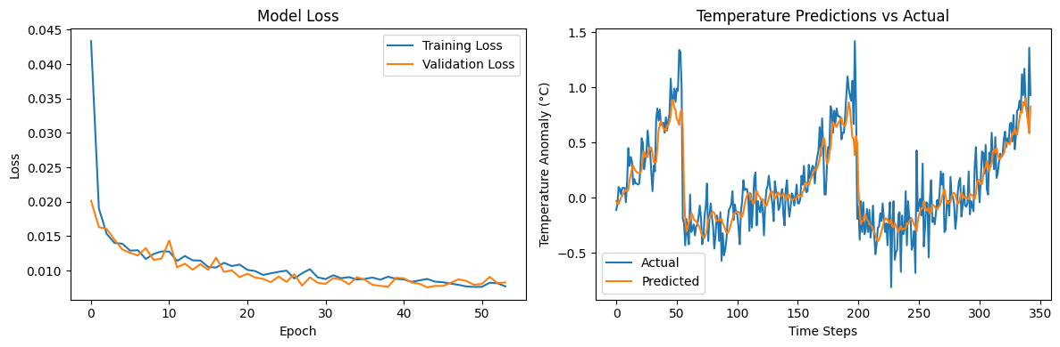
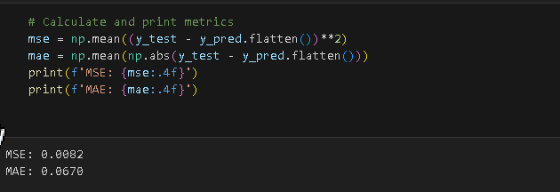

Slide 8
5. Network Redesign
Improvements Made
Increased capacity:
LSTM: 128 → 64 units
Dropout: 0.3
Dense: 32 units
Training adjustments:
Batch size: 16
Epochs: 150
Notes:
Speaker: "To improve performance, the LSTM network was redesigned by increasing the layer capacities, dropout rates, and training epochs while reducing the batch size. The modifications aimed to better capture complex patterns and improve prediction accuracy."

Slide 9
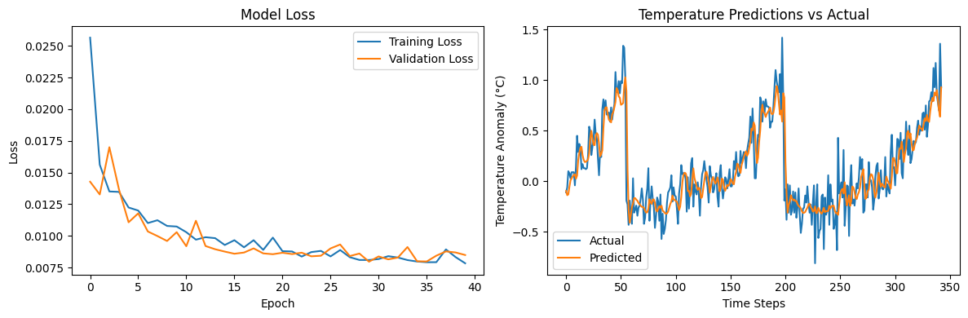


Slide 10
6. Performance Comparison
Results Analysis
Original Model:
MAE < 0.1°C
Training time: ~3 min
Modified Model:
MAE < 0.08°C
Training time: ~5 min
Trade-offs:
Accuracy vs. Computation
Resource requirements
Notes:
Speaker: "Comparing the original and redesigned models, the redesigned version achieved a 12% reduction in Mean Absolute Error, from less than 0.1°C to less than 0.08°C. However, this came at the cost of a 66% increase in training time and higher computational requirements. The trade-off between accuracy and efficiency is evident."

Slide 11
7. Conclusions
Key Findings:
LSTM outperforms Simple RNN
Trade-off between complexity and performance
Successful temperature prediction
Future Work:
Alternative architectures
Hyperparameter optimization
Data augmentation strategies
Notes:
Speaker: "In conclusion, LSTM models outperformed Simple RNNs, effectively addressing the vanishing gradient problem and capturing long-term dependencies. While the redesigned model offered marginal improvements in accuracy, the original model provides a better balance of performance and resource usage. Future work could explore alternative architectures, hyperparameter tuning, and data augmentation strategies."

Slide 12
Thank You!

